Slide 1
Hotel Management System

Slide 2
Introduction
A Hotel Management system is a c++ programming code designed to help users maintain and organize their Hotels. The system processes
transactions and stores the resulting data.
Reports will be generated from these data
which help the manager to make appropriate
Business decisions for the restaurant.

Slide 3
Restaurant Management system
OBJECTIVE
The objective of this project is to generate a bill/invoice in Hotels or Restaurants.

Slide 4
List of some features
Reservation system.
Manage Rooms
Check –In
Check -out
Available Room
Guest summary Report

Slide 5
The objective of the restaurant
billing system
Availability: all bills of the restaurants are stored permanently in the Database admin can see the data in the availability of any information.
Maintain cost: reduce the cost of maintenance. It is a standalone application so No required cost for maintaining it.
Flexibility: the system should be modifiable depending on the changing needs Of the user. It should also be portable to a different computer system but not Other than windows os.

Slide 6
Need for Hotel management system
Simple menu setup.
User-friendly order management.
Customer management.
Better customer service.
User Support.

Slide 7
admin
Hotel
Management system
database

Slide 8
Algorithm
An structure of the Management system.
Show all Options Available.
Manage Rooms
Check-in, Check out.
Available Rooms
Guest’s Summary

Slide 9
Algorithm
Classes
Objects
Loops
Arrays
Functions
File Handling

Slide 10
Features of c++ language used
1. Class and Objectives.
2. Arrays.
3. Functions.
4. Structures.
5. File handling

Slide 11
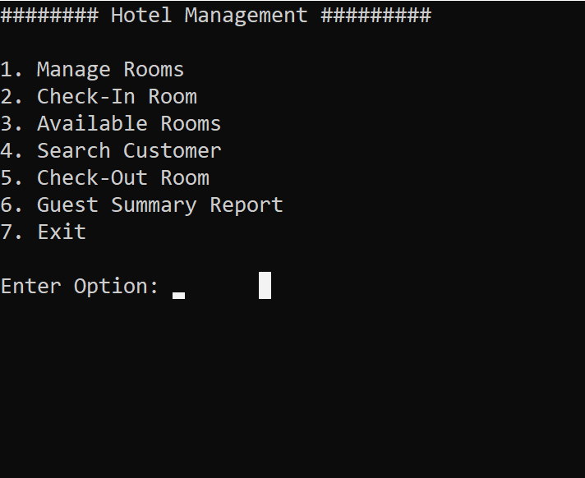
Input :

Slide 12
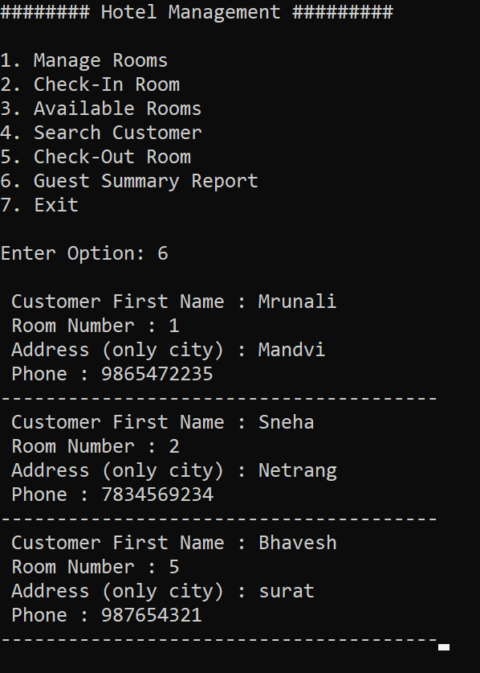
Output(summary) :

Slide 13
conclusion
We have a system in which the outcome of all the time’s hard work is here. There has a system that takes the necessary choice of the customers according to the filter like the category of the Rooms. This is achieved through an easy to use graphical interface menu options. The users can add any number of items to the cart from any of the available Rooms categories and get the bill.
Customer according to the choice pay bill via cash or debit card or credit card method. Hence all the processes work perfectly, fulfilling demand.

Slide 14

By Bhavesh P. Chavda

